Slide 1
Greedy Method
Activity Selection Problem

Slide 2
Greedy Method – General Method
Elements of Greedy Method
Greedy Algorithms
Activity Selection Problem
Huffman Coding
Fractional knapsack problem

Slide 3
Greedy Method
A design strategy for solving Problems
Solves Optimization Problems
Requires min/max results
Problem
A→B
Constraint→10 hrs
Objective fn→min
Sol3
Sol4
Sol5
Sol1
Sol2
Feasible Solns
Optimal Soln

Slide 4
Greedy algorithms
A greedy algorithm always makes the choice that looks best at the moment
The hope: a locally optimal choice will lead to a globally optimal solution
For some problems, it works
greedy algorithms tend to be easier to code

Slide 5
Greedy Choice must be
Feasible
Satisfy the problem’s constraints
Locally optimal
Be the best local choice among all feasible choices
Irrevocable
Once made, the choice can’t be changed on subsequent steps.

Slide 6
The General Method
An algorithm that works in stages considering one input at a time
At each stage a decision is made whether the input gives an optimal solution
This is done by considering the inputs in an order determined by some selection procedure
If the partial solution is not optimal then it is not added to the solution
The selection procedure is based on some optimization measure, the measure may be the objective function

Slide 7
Greedy Algorithm
Algorithm Greedy(a,n)
{ Solution:=Ø
for i:=1 to n do
{
x:=Select(a);
if Feasible(Solution,x)
Solution:=Union(solution,x);
}
return Solution;
}

Slide 8
Greedy Algorithm
Select → The function Select selects an input from a[] and removes it. The selected value is assigned to x.
Feasible → Is a Boolean-valued function that determines whether x can be included into the solution vector.
Union → The function Union combines x with the Solution.

Slide 9
An Activity Selection Problem (Conference Scheduling Problem)
Input: A set of activities S = {a₁,…, a_{n}}
Each activity has start time and a finish time
a_{i}=(s_{i}, f_{i})
Two activities are compatible if and only if their interval does not overlap
Output: a maximum-size subset of mutually compatible activities

Slide 10
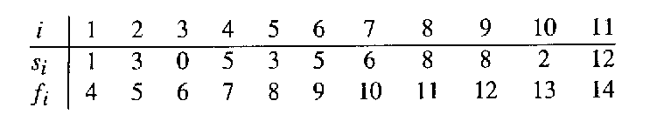
The Activity Selection Problem
Here are a set of start and finish times
What is the maximum number of activities that can be completed?
{a₃, a₉, a₁₁} can be completed
But so can {a₁, a₄, a_{8’} a₁₁} which is a larger set
But it is not unique, consider {a₂, a₄, a_{9’} a₁₁}

Slide 11
a1
a2
a3
a4
a5
a6
a7
a8
a9
a10
a11
0 1 2 3 4 5 6 7 8 9 10 11 12 13 14 15

Slide 12
a1
a2
a3
a4
a5
a6
a7
a8
a9
a10
a11
0 1 2 3 4 5 6 7 8 9 10 11 12 13 14 15

Slide 13
a1
a2
a3
a4
a5
a6
a7
a8
a9
a10
a11
0 1 2 3 4 5 6 7 8 9 10 11 12 13 14 15

Slide 14
a1
a2
a3
a4
a5
a6
a7
a8
a9
a10
a11
0 1 2 3 4 5 6 7 8 9 10 11 12 13 14 15

Slide 15
Early Finish Greedy
Select the activity with the earliest finish
Eliminate the activities that could not be scheduled
Repeat!

Slide 16
a1
a2
a3
a4
a5
a6
a7
a8
a9
a10
a11
0 1 2 3 4 5 6 7 8 9 10 11 12 13 14 15

Slide 17
a1
a2
a3
a4
a5
a6
a7
a8
a9
a10
a11
0 1 2 3 4 5 6 7 8 9 10 11 12 13 14 15

Slide 18
a1
a2
a3
a4
a5
a6
a7
a8
a9
a10
a11
0 1 2 3 4 5 6 7 8 9 10 11 12 13 14 15

Slide 19
a1
a2
a3
a4
a5
a6
a7
a8
a9
a10
a11
0 1 2 3 4 5 6 7 8 9 10 11 12 13 14 15

Slide 20
Problem
Start Time (s) | Finish Time (f) | Activity Name
5 | 9 | a1
1 | 2 | a2
3 | 4 | a3
0 | 6 | a4
5 | 7 | a5
8 | 9 | a6

Slide 21
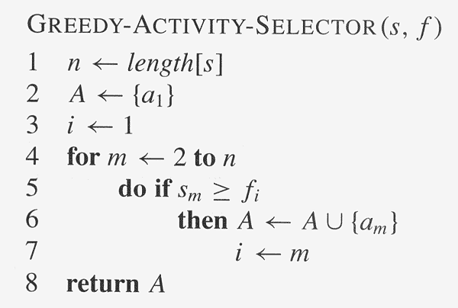
Assuming activities are sorted by finish time

Slide 22
Why it is Greedy?
Greedy in the sense that it leaves as much opportunity as possible for the remaining activities to be scheduled
The greedy choice is the one that maximizes the amount of unscheduled time remaining

Slide 23
Elements of Greedy Strategy
A greedy algorithm makes a sequence of choices, each of the choices that seems best at the moment is chosen
NOT always produce an optimal solution
Two ingredients that are exhibited by most problems that lend themselves to a greedy strategy
Greedy-choice property
Optimal substructure

Slide 24
Greedy-Choice Property
A globally optimal solution can be arrived at by making a locally optimal (greedy) choice
Make whatever choice seems best at the moment and then solve the sub-problem arising after the choice is made
The choice made by a greedy algorithm may depend on choices so far, but it cannot depend on any future choices or on the solutions to sub-problems
A greedy choice at each step yields a globally optimal solution

Slide 25

Optimal Substructures
A problem exhibits optimal substructure if an optimal solution to the problem contains within it optimal solutions to the sub-problems.
If an optimal solution A to S begins with activity 1,
A’=A – {1} is optimal to S’={ i$∈S:si> =f1\}$

Slide 26
Greedy Algorithm Design
Comparison:
Dynamic Programming
Greedy Algorithms
At each step, the choice is determined based on solutions of subproblems.
At each step, we quickly make a choice that currently looks best. --A local optimal (greedy) choice.
Sub-problems are solved first.
Greedy choice can be made first before solving further sub-problems.
Bottom-up approach
Can be slower, more complex
Top-down approach
Usually faster, simpler

